Slide 2

Your Turn
Open 02-Transform-Data.Rmd.

Slide 3

babynames
Names of male and female babies born in the US from 1880 to 2015. 1.8M rows.
R package
# install.packages("babynames")
library(babynames)
CC BY-SA RStudio

Slide 4
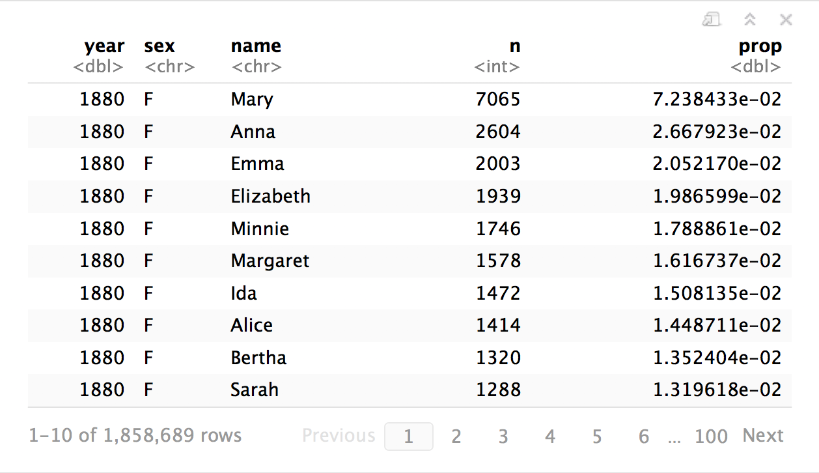
babynames
CC BY-SA RStudio

Slide 5

tibbles

Slide 6
tibbles
A type of data frame common throughout tidyverse packages. Tibbles enhance data frames in three ways:
Subsetting - [ always returns a new tibble, [[ and $ always return a new vector
No partial matching - You must use full column names when subsetting
Display - When you print a tibble, R provides a concise view of the data that fits on one screen
CC BY-SA RStudio

Slide 7
# A tibble: 234 × 6
manufacturer model displ
<chr> <chr> <dbl>
1 audi a4 1.8
2 audi a4 1.8
3 audi a4 2.0
4 audi a4 2.0
5 audi a4 2.8
6 audi a4 2.8
7 audi a4 3.1
8 audi a4 quattro 1.8
9 audi a4 quattro 1.8
10 audi a4 quattro 2.0
# ... with 224 more rows, and 3
# more variables: year <int>,
# cyl <int>, trans <chr>
wind | wind | wind
tibble display
156 1999 6 auto(l4)
157 1999 6 auto(l4)
158 2008 6 auto(l4)
159 2008 8 auto(s4)
160 1999 4 manual(m5)
161 1999 4 auto(l4)
162 2008 4 manual(m5)
163 2008 4 manual(m5)
164 2008 4 auto(l4)
165 2008 4 auto(l4)
166 1999 4 auto(l4)
[ reached getOption("max.print") -- omitted 68 rows ]
A large table to display
data frame display
CC BY-SA RStudio

Slide 8
tibble
R package
A package with several helper functions for tibbles:
as_tibble() - convert a data frame to a tibble
as.data.frame() - convert a tibble to a data frame
tribble() - make a tibble (transversed)
tribble(
~x, ~y,
1, "a",
2, "b",
3, "c")
x | y
1 | a
2 | b
3 | c
CC BY-SA RStudio

Slide 9
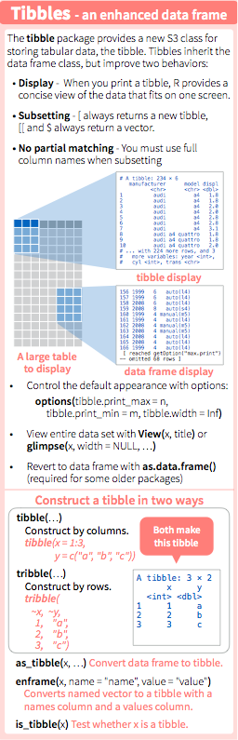
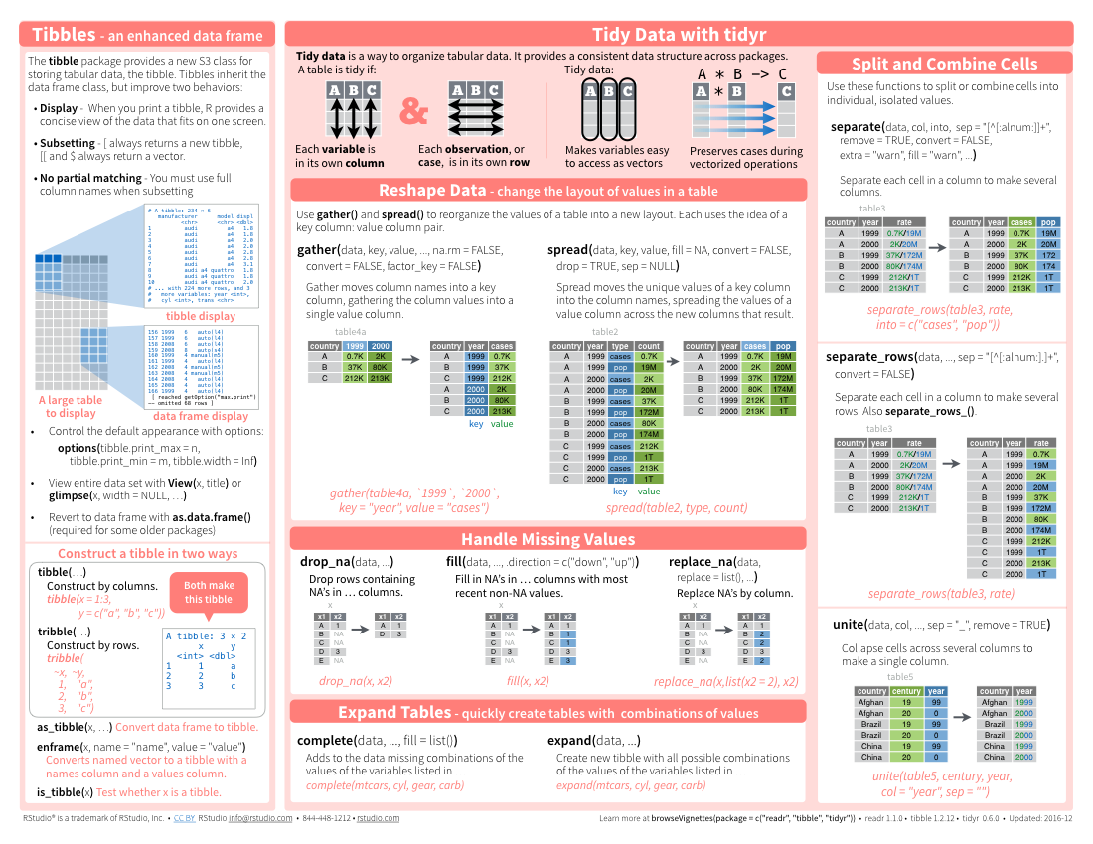
tibbles
CC BY-SA RStudio

Slide 10
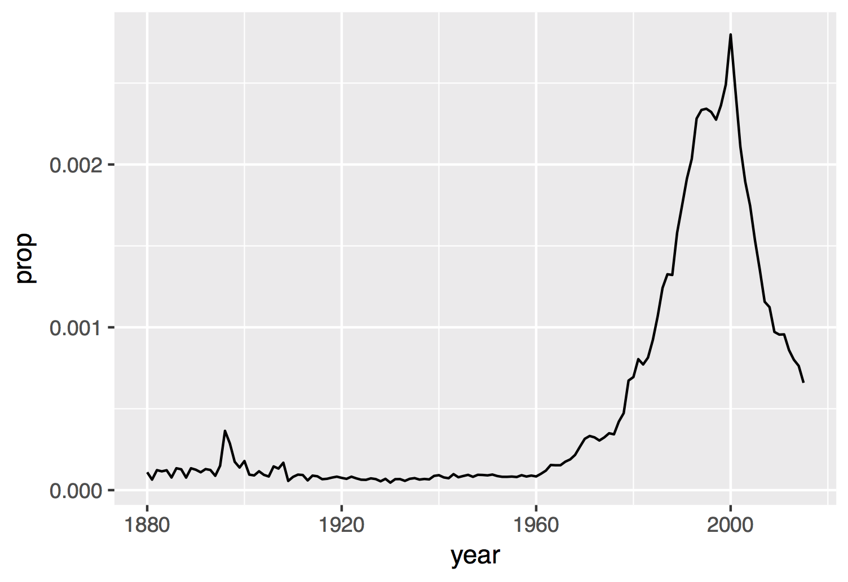
Proportion of boys with the name Garrett
CC BY-SA RStudio

Slide 11
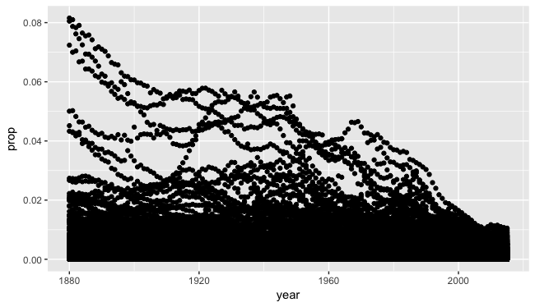
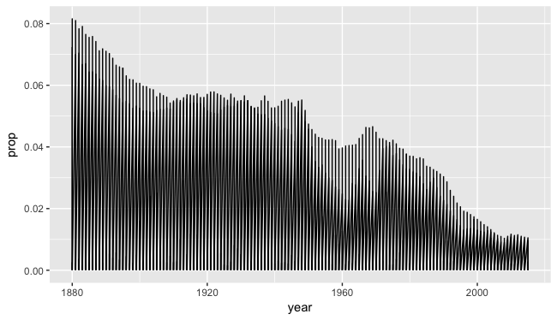
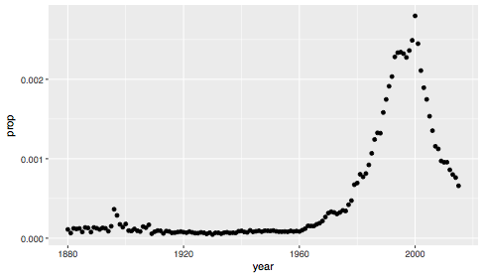
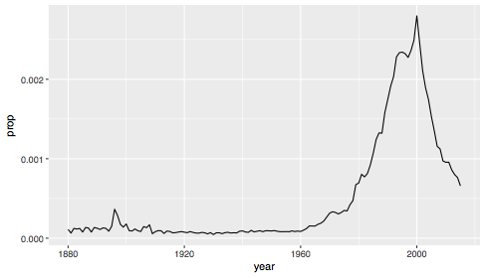
CC BY-SA RStudio

Slide 12
How to isolate?
year | sex | name | n | prop
1880 | M | John | 9655 | 0.0815
1880 | M | William | 9532 | 0.0805
1880 | M | James | 5927 | 0.0501
1880 | M | Charles | 5348 | 0.0451
1880 | M | Garrett | 13 | 0.0001
1881 | M | John | 8769 | 0.081
1881 | M | William | 8524 | 0.0787
1881 | M | James | 5442 | 0.0503
1881 | M | Charles | 4664 | 0.0431
1881 | M | Garrett | 7 | 0.0001
1881 | M | Gideon | 7 | 0.0001
year | sex | name | n | prop
1880 | M | Garrett | 13 | 0.0001
1881 | M | Garrett | 7 | 0.0001
… | … | Garrett | … | …
CC BY-SA RStudio

Slide 13
dplyr

Slide 14
dplyr
A package that transforms data.
dplyr implements a grammar for transforming tabular data.
CC BY-SA RStudio

Slide 15
Isolating data
select() - extract variables
filter() - extract cases
arrange() - reorder cases
CC BY-SA RStudio

Slide 16
select()

Slide 17
select()
Extract columns by name.
select(.data, …)
data frame to transform
name(s) of columns to extract
(or a select helper function)
CC BY-SA RStudio

Slide 18
select()
Extract columns by name.
select(babynames, name, prop)
babynames
year | sex | name | n | prop
1880 | M | John | 9655 | 0.0815
1880 | M | William | 9532 | 0.0805
1880 | M | James | 5927 | 0.0501
1880 | M | Charles | 5348 | 0.0451
1880 | M | Garrett | 13 | 0.0001
1881 | M | John | 8769 | 0.081
1881 | M | William | 8524 | 0.0787
1881 | M | James | 5442 | 0.0503
1881 | M | Charles | 4664 | 0.0431
1881 | M | Garrett | 7 | 0.0001
1881 | M | Gideon | 7 | 0.0001
name | prop
John | 0.0815
William | 0.0805
James | 0.0501
Charles | 0.0451
Garrett | 0.0001
John | 0.081
William | 0.0787
James | 0.0503
Charles | 0.0431
Garrett | 0.0001
Gideon | 0.0001
CC BY-SA RStudio

Slide 19
Your Turn 1
Alter the code to select just the n column:
select(babynames, name, prop)

Slide 20
select(babynames, n)
# n
# <int>
# 1 7065
# 2 2604
# 3 2003
# 4 1939
# 5 1746
# … …
CC BY-SA RStudio

Slide 21
select() helpers
Select range of columns
select(storms, storm:pressure)
Select every column but
select(storms, -c(storm, pressure))
starts_with() - Select columns that start with…
select(storms, starts_with("w"))
ends_with() - Select columns that end with…
select(storms, ends_with("e"))
CC BY-SA RStudio

Slide 22
select() helpers
contains() - Select columns whose names contain…
select(storms, contains("d"))
matches() - Select columns whose names match regular expression
select(storms, matches("^.{4}$"))
one_of() - Select columns whose names are one of a set
select(storms, one_of(c("storm", "storms", "Storm"))
num_range() - Select columns named in prefix, number style
select(storms, num_range("x", 1:5))
CC BY-SA RStudio

Slide 23
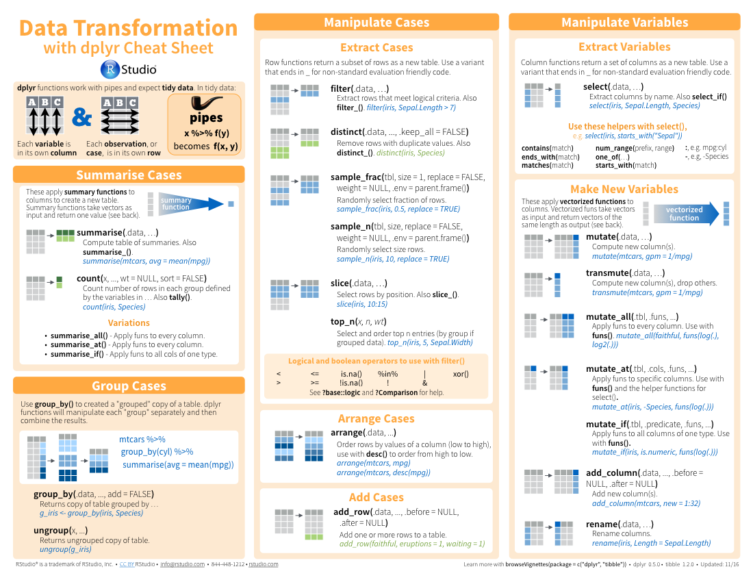
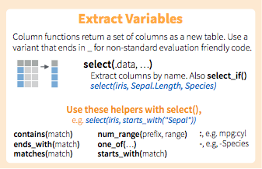
select() helpers
CC BY-SA RStudio

Slide 24
Quiz
Which of these is NOT a way to select the name and n columns together?
select(babynames, -c(year, sex, prop))
select(babynames, name:n)
select(babynames, starts_with("n"))
select(babynames, ends_with("n"))

Slide 25
Quiz
Which of these is NOT a way to select the name and n columns together?
select(babynames, -c(year, sex, prop))
select(babynames, name:n)
select(babynames, starts_with("n"))
select(babynames, ends_with("n"))

Slide 26
filter()

Slide 27
filter()
Extract rows that meet logical criteria.
filter(.data, … )
data frame to transform
one or more logical tests (filter returns each row for which the test is TRUE)
CC BY-SA RStudio

Slide 28
common syntax
Each function takes a data frame / tibble as its first argument and returns a data frame / tibble.
filter(.data, … )
dplyr function
data frame to transform
Function specific arguments
CC BY-SA RStudio

Slide 29
filter()
Extract rows that meet logical criteria.
filter(babynames, name == "Garrett")
babynames
year | sex | name | n | prop
1880 | M | John | 9655 | 0.0815
1880 | M | William | 9532 | 0.0805
1880 | M | James | 5927 | 0.0501
1880 | M | Charles | 5348 | 0.0451
1880 | M | Garrett | 13 | 0.0001
1881 | M | John | 8769 | 0.081
1881 | M | William | 8524 | 0.0787
1881 | M | James | 5442 | 0.0503
1881 | M | Charles | 4664 | 0.0431
1881 | M | Garrett | 7 | 0.0001
1881 | M | Gideon | 7 | 0.0001
year | sex | name | n | prop
1880 | M | Garrett | 13 | 0.0001
1881 | M | Garrett | 7 | 0.0001
… | … | Garrett | … | …
CC BY-SA RStudio

Slide 30
filter()
Extract rows that meet logical criteria.
filter(babynames, name == "Garrett")
babynames
year | sex | name | n | prop
1880 | M | John | 9655 | 0.0815
1880 | M | William | 9532 | 0.0805
1880 | M | James | 5927 | 0.0501
1880 | M | Charles | 5348 | 0.0451
1880 | M | Garrett | 13 | 0.0001
1881 | M | John | 8769 | 0.081
1881 | M | William | 8524 | 0.0787
1881 | M | James | 5442 | 0.0503
1881 | M | Charles | 4664 | 0.0431
1881 | M | Garrett | 7 | 0.0001
1881 | M | Gideon | 7 | 0.0001
= sets
(returns nothing)
== tests if equal
(returns TRUE or FALSE)
CC BY-SA RStudio

Slide 31
Logical tests
?Comparison
x < y | Less than
x > y | Greater than
x == y | Equal to
x <= y | Less than or equal to
x >= y | Greater than or equal to
x != y | Not equal to
x %in% y | Group membership
is.na(x) | Is NA
!is.na(x) | Is not NA
CC BY-SA RStudio

Slide 32

Your Turn 2
See if you can use the logical operators to manipulate our code below to show:
• All of the names where prop is greater than or equal to 0.08
• All of the children named “Sea”
• All of the names that have a missing value for n
(Hint: this should return an empty data set).

Slide 33
filter(babynames, prop >= 0.08)
# year sex name n prop
# 1 1880 M John 9655 0.08154630
# 2 1880 M William 9531 0.08049899
# 3 1881 M John 8769 0.08098299
filter(babynames, name == "Sea")
# year sex name n prop
# 1 1982 F Sea 5 2.756771e-06
# 2 1985 M Sea 6 3.119547e-06
# 3 1986 M Sea 5 2.603512e-06
# 4 1998 F Sea 5 2.580377e-06
filter(babynames, is.na(n))
# 0 rows
CC BY-SA RStudio

Slide 34
Two common mistakes
1. Using = instead of ==
filter(babynames, name = "Sea")
filter(babynames, name == "Sea")
2. Forgetting quotes
filter(babynames, name == Sea)
filter(babynames, name == "Sea")
CC BY-SA RStudio

Slide 35
filter()
Extract rows that meet every logical criteria.
filter(babynames, name == "Garrett", year == 1880)
babynames
year | sex | name | n | prop
1880 | M | John | 9655 | 0.0815
1880 | M | William | 9532 | 0.0805
1880 | M | James | 5927 | 0.0501
1880 | M | Charles | 5348 | 0.0451
1880 | M | Garrett | 13 | 0.0001
1881 | M | John | 8769 | 0.081
1881 | M | William | 8524 | 0.0787
1881 | M | James | 5442 | 0.0503
1881 | M | Charles | 4664 | 0.0431
1881 | M | Garrett | 7 | 0.0001
1881 | M | Gideon | 7 | 0.0001
year | sex | name | n | prop
1880 | M | Garrett | 13 | 0.0001
CC BY-SA RStudio

Slide 36
Boolean operators
?base::Logic
a & b | and
a | b | or
xor(a,b) | exactly or
!a | not
CC BY-SA RStudio

Slide 37
filter()
Extract rows that meet every logical criteria.
filter(babynames, name == "Garrett" & year == 1880)
babynames
year | sex | name | n | prop
1880 | M | John | 9655 | 0.0815
1880 | M | William | 9532 | 0.0805
1880 | M | James | 5927 | 0.0501
1880 | M | Charles | 5348 | 0.0451
1880 | M | Garrett | 13 | 0.0001
1881 | M | John | 8769 | 0.081
1881 | M | William | 8524 | 0.0787
1881 | M | James | 5442 | 0.0503
1881 | M | Charles | 4664 | 0.0431
1881 | M | Garrett | 7 | 0.0001
1881 | M | Gideon | 7 | 0.0001
year | sex | name | n | prop
1880 | M | Garrett | 13 | 0.0001
CC BY-SA RStudio

Slide 38
Your Turn 3
Use Boolean operators to alter the code below to return only the rows that contain:
• Girls named Sea
• Names that were used by exactly 5 or 6 children in 1880
• Names that are one of Acura, Lexus, or Yugo
filter(babynames, name == "Sea" | name == "Anemone")

Slide 39
filter(babynames, name == "Sea", sex == "F")
# year sex name n prop
# 1 1982 F Sea 5 2.756771e-06
# 2 1998 F Sea 5 2.580377e-06
filter(babynames, n == 5 | n == 6, year == 1880)
# year sex name n prop
# 1 1880 F Abby 6 6.147289e-05
# 2 1880 F Aileen 6 6.147289e-05
# … … … … … …
filter(babynames, name %in% c("Acura", "Lexus", "Yugo"))
# year sex name n prop
# 1 1990 F Lexus 36 1.752932e-05
# 2 1990 M Lexus 12 5.579156e-06
# … … … … … …
CC BY-SA RStudio

Slide 40
Two more common mistakes
3. Collapsing multiple tests into one
filter(babynames, 10 < n < 20)
filter(babynames, 10 < n, n < 20)
4. Stringing together many tests (when you could use %in%)
filter(babynames, n == 5 | n == 6 | n == 7 | n == 8)
filter(babynames, n %in% c(5, 6, 7, 8))
CC BY-SA RStudio

Slide 41
arrange()

Slide 42
arrange()
Order rows from smallest to largest values.
arrange(.data, …)
data frame to transform
one or more columns to order by
(additional columns will be used as tie breakers)
CC BY-SA RStudio

Slide 43
arrange()
Order rows from smallest to largest values.
arrange(babynames, n)
babynames
year | sex | name | n | prop
1880 | M | John | 9655 | 0.0815
1880 | M | William | 9532 | 0.0805
1880 | M | James | 5927 | 0.0501
1880 | M | Charles | 5348 | 0.0451
1880 | M | Garrett | 13 | 0.0001
1881 | M | John | 8769 | 0.081
1881 | M | William | 8524 | 0.0787
1881 | M | James | 5442 | 0.0503
1881 | M | Charles | 4664 | 0.0431
1881 | M | Garrett | 7 | 0.0001
1881 | M | Gideon | 7 | 0.0001
year | sex | name | n | prop
1880 | M | Garrett | 13 | 0.0001
1880 | M | Charles | 5348 | 0.0451
1880 | M | James | 5927 | 0.0501
1881 | M | John | 8769 | 0.081
1880 | M | William | 9532 | 0.0805
1880 | M | John | 9655 | 0.0815
1881 | M | William | 8524 | 0.0787
1881 | M | James | 5442 | 0.0503
1881 | M | Charles | 4664 | 0.0431
1881 | M | Garrett | 7 | 0.0001
1881 | M | Gideon | 7 | 0.0001
CC BY-SA RStudio

Slide 44
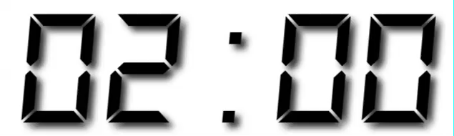
Your Turn 4
Arrange babynames by n. Add prop as a second (tie breaking) variable to arrange on.
Can you tell what the smallest value of n is?

Slide 45
arrange(babynames, n, prop)
# year sex name n prop
# 1 2007 M Aaban 5 2.259872e-06
# 2 2007 M Aareon 5 2.259872e-06
# 3 2007 M Aaris 5 2.259872e-06
# 4 2007 M Abd 5 2.259872e-06
# 5 2007 M Abdulazeez 5 2.259872e-06
# 6 2007 M Abdulhadi 5 2.259872e-06
# 7 2007 M Abdulhamid 5 2.259872e-06
# 8 2007 M Abdulkadir 5 2.259872e-06
# 9 2007 M Abdulraheem 5 2.259872e-06
# 10 2007 M Abdulrahim 5 2.259872e-06
# ... with 1,858,679 more rows
CC BY-SA RStudio

Slide 46
desc()
Changes ordering to largest to smallest.
arrange(babynames, desc(n))
babynames
year | sex | name | n | prop
1880 | M | John | 9655 | 0.0815
1880 | M | William | 9532 | 0.0805
1880 | M | James | 5927 | 0.0501
1880 | M | Charles | 5348 | 0.0451
1880 | M | Garrett | 13 | 0.0001
1881 | M | John | 8769 | 0.081
1881 | M | William | 8524 | 0.0787
1881 | M | James | 5442 | 0.0503
1881 | M | Charles | 4664 | 0.0431
1881 | M | Garrett | 7 | 0.0001
1881 | M | Gideon | 7 | 0.0001
year | sex | name | n | prop
1880 | M | John | 9655 | 0.0815
1880 | M | William | 9532 | 0.0805
1881 | M | John | 8769 | 0.081
1880 | M | James | 5927 | 0.0501
1880 | M | Charles | 5348 | 0.0451
1880 | M | Garrett | 13 | 0.0001
1881 | M | William | 8524 | 0.0787
1881 | M | James | 5442 | 0.0503
1881 | M | Charles | 4664 | 0.0431
1881 | M | Garrett | 7 | 0.0001
1881 | M | Gideon | 7 | 0.0001
CC BY-SA RStudio

Slide 47
Your Turn 5
Use desc() to find the names with the highest prop.
Then, use desc() to find the names with the highest n.

Slide 48
arrange(babynames, desc(prop))
# year sex name n prop
# 1 1880 M John 9655 0.08154630
# 2 1881 M John 8769 0.08098299
# 3 1880 M William 9531 0.08049899
# 4 1883 M John 8894 0.07907324
# 5 1881 M William 8524 0.07872038
# 6 1882 M John 9557 0.07831617
# 7 1884 M John 9388 0.07648751
# 8 1882 M William 9298 0.07619375
# 9 1886 M John 9026 0.07582198
# 10 1885 M John 8756 0.07551791
# ... with 1,858,679 more rows
arrange(babynames, desc(n))
# year sex name n prop
# 1 1947 F Linda 99680 0.05483609
# 2 1948 F Linda 96211 0.05521159
# 3 1947 M James 94763 0.05102057
# 4 1957 M Michael 92726 0.04238659
# 5 1947 M Robert 91646 0.04934237
# 6 1949 F Linda 91010 0.05184281
# 7 1956 M Michael 90623 0.04225479
# 8 1958 M Michael 90517 0.04203881
# 9 1948 M James 88588 0.04969679
# 10 1954 M Michael 88493 0.04279403
# ... with 1,858,679 more rows
CC BY-SA RStudio

Slide 49
%>%

Slide 50
Steps
boys_2015 <- filter(babynames, year == 2015, sex == "M")
boys_2015 <- select(boys_2015, name, n)
boys_2015 <- arrange(boys_2015, desc(n))
boys_2015
1. Filter babynames to just boys born in 2015
2. Select the name and n columns from the result
3. Arrange those columns so that the most popular names appear near the top.
CC BY-SA RStudio

Slide 51
Steps
boys_2015 <- filter(babynames, year == 2015, sex == "M")
boys_2015 <- select(boys_2015, name, n)
boys_2015 <- arrange(boys_2015, desc(n))
boys_2015
CC BY-SA RStudio

Slide 52
Steps
arrange(select(filter(babynames, year == 2015,
sex == "M"), name, n), desc(n))
CC BY-SA RStudio

Slide 53
The pipe operator %>%
%>%
babynames filter( , n == 99680)
Passes result on left into first argument of function on right. So, for example, these do the same thing. Try it
filter(babynames, n == 99680)
babynames %>% filter(n == 99680)
CC BY-SA RStudio

Slide 54
Pipes
boys_2015 <- filter(babynames, year == 2015, sex == "M")
boys_2015 <- select(boys_2015, name, n)
boys_2015 <- arrange(boys_2015, desc(n))
boys_2015
babynames %>%
filter(year == 2015, sex == "M") %>%
select(name, n) %>%
arrange(desc(n))
CC BY-SA RStudio

Slide 55
foo_foo <- little_bunny()
foo_foo %>%
hop_through(forest) %>%
scoop_up(field_mouse) %>%
bop_on(head)
vs.
foo_foo2 <- hop_through(foo_foo, forest)
foo_foo3 <- scoop_up(foo_foo2, field_mouse)
bop_on(foo_foo3, head)
CC BY-SA RStudio

Slide 56
Shortcut to type %>%
Cmd
+
Shift
+
M
(Mac)
Ctrl
+
Shift
+
M
(Windows)
CC BY-SA RStudio

Slide 57
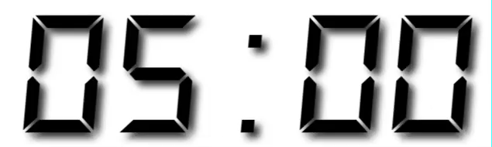
Your Turn 6
Use %>% to write a sequence of functions that:
Filter babynames to just the girls that were born in 2015
Select the name and n columns
Arrange the results so that the most popular names are near the top.

Slide 58
babynames %>%
filter(year == 2015, sex == "F") %>%
select(name, n) %>%
arrange(desc(n))
# name n
# 1 Emma 20355
# 2 Olivia 19553
# 3 Sophia 17327
# 4 Ava 16286
# 5 Isabella 15504
# 6 Mia 14820
# 7 Abigail 12311
# 8 Emily 11727
# 9 Charlotte 11332
# 10 Harper 10241
# ... with 18,983 more rows
CC BY-SA RStudio

Slide 59
Exam
Trim babynames to just the rows that contain your name and your sex
Trim the result to just the columns that will appear in your graph (not strictly necessary, but useful practice)
Plot the results as a line graph with year on the x axis and prop on the y axis

Slide 60

babynames %>%
filter(name == "Garrett", sex == "M") %>%
select(year, prop) %>%
ggplot() +
geom_line(mapping = aes(year, prop))
CC BY-SA RStudio

Slide 61
What are the most popular names?

Slide 62
How should we define popularity?
A name is popular if:
Sums - a large number of children have the name when you sum across years
Ranks - it consistently ranks among the top names from year to year.
CC BY-SA RStudio

Slide 63
How should we define popularity?
A name is popular if:
Sums - a large number of children have the name when you sum across years
Ranks - it consistently ranks among the top names from year to year.
CC BY-SA RStudio

Slide 64
How should we define popularity?
A name is popular if:
Sums - a large number of children have the name when you sum across years
Ranks - it consistently ranks among the top names from year to year.
CC BY-SA RStudio

Slide 65
Quiz
Do we have enough information to:
Calculate the total number of children with each name?
Rank names within each year?

Slide 66
Deriving information
summarise() - summarise variables
group_by() - group cases
mutate() - create new variables
CC BY-SA RStudio

Slide 67
summarise()

Slide 68
summarise()
Compute table of summaries.
babynames %>% summarise(total = sum(n), max = max(n))
babynames
year | sex | name | n | prop
1880 | M | John | 9655 | 0.0815
1880 | M | William | 9532 | 0.0805
1880 | M | James | 5927 | 0.0501
1880 | M | Charles | 5348 | 0.0451
1880 | M | Garrett | 13 | 0.0001
1881 | M | John | 8769 | 0.081
1881 | M | William | 8524 | 0.0787
1881 | M | James | 5442 | 0.0503
1881 | M | Charles | 4664 | 0.0431
1881 | M | Garrett | 7 | 0.0001
1881 | M | Gideon | 7 | 0.0001
total | max
127538 | 99680
CC BY-SA RStudio

Slide 69
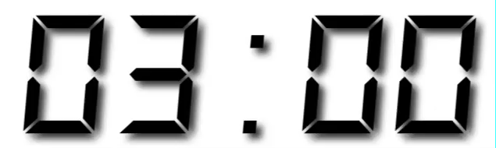
Your Turn 7
Use summarise() to compute three statistics about the data:
The first (minimum) year in the dataset
The last (maximum) year in the dataset
The total number of children represented in the data

Slide 70
babynames %>%
summarise(first = min(year),
last = max(year),
total = sum(n))
# first last total
# 1 1880 2015 340851912
CC BY-SA RStudio

Slide 71
Your Turn 8
Extract the rows where name == "Khaleesi". Then use summarise() and a summary functions to find:
The total number of children named Khaleesi
The first year Khaleesi appeared in the data

Slide 72
babynames %>%
filter(name == "Khaleesi") %>%
summarise(total = sum(n), first = min(year))
# total first
# 1 1127 2011
CC BY-SA RStudio

Slide 73
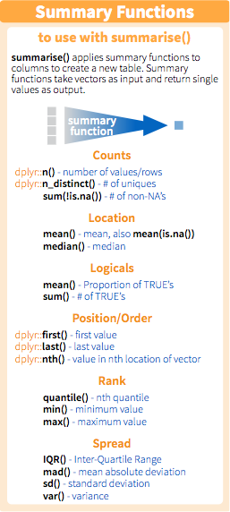
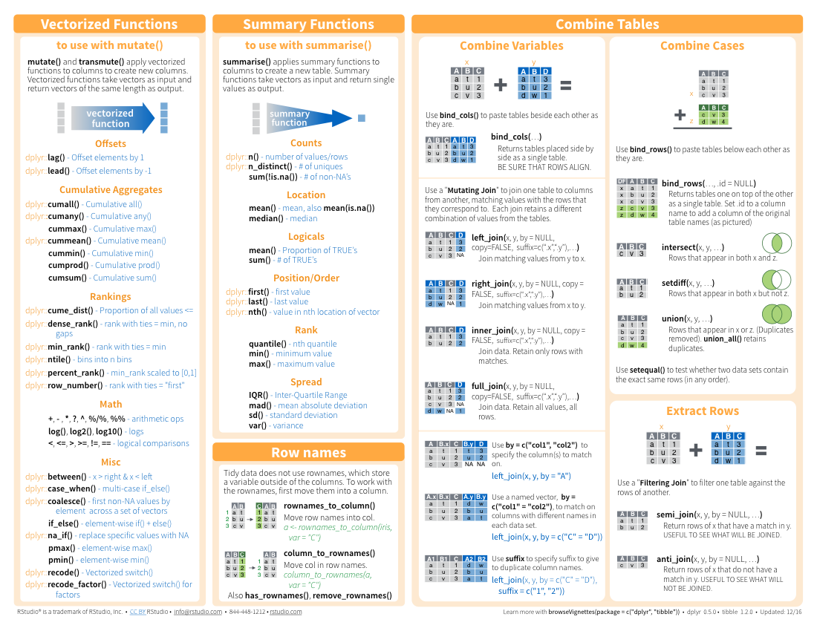
Summary functions
Take a vector as input.
Return a single value as output.
CC BY-SA RStudio

Slide 74
n()
The number of rows in a dataset/group
babynames %>% summarise(n = n())
babynames
year | sex | name | n | prop
1880 | M | John | 9655 | 0.0815
1880 | M | William | 9532 | 0.0805
1880 | M | James | 5927 | 0.0501
1880 | M | Charles | 5348 | 0.0451
1880 | M | Garrett | 13 | 0.0001
1881 | M | John | 8769 | 0.081
1881 | M | William | 8524 | 0.0787
1881 | M | James | 5442 | 0.0503
1881 | M | Charles | 4664 | 0.0431
1881 | M | Garrett | 7 | 0.0001
1881 | M | Gideon | 7 | 0.0001
n
1858689
CC BY-SA RStudio

Slide 75
n_distinct()
The number of distinct values in a variable
babynames %>% summarise(n = n(), nname = n_distinct(name))
babynames
year | sex | name | n | prop
1880 | M | John | 9655 | 0.0815
1880 | M | William | 9532 | 0.0805
1880 | M | James | 5927 | 0.0501
1880 | M | Charles | 5348 | 0.0451
1880 | M | Garrett | 13 | 0.0001
1881 | M | John | 8769 | 0.081
1881 | M | William | 8524 | 0.0787
1881 | M | James | 5442 | 0.0503
1881 | M | Charles | 4664 | 0.0431
1881 | M | Garrett | 7 | 0.0001
1881 | M | Gideon | 7 | 0.0001
n | nname
1858689 | 95025
CC BY-SA RStudio

Slide 76
Grouping
cases

Slide 77
group_by()
Groups cases by common values of one or more columns.
babynames %>%
group_by(sex)
babynames %>% group_by(sex)
Source: local data frame [1,825,433 x 5]
Groups: sex [2]
year sex name n prop
<dbl> <chr> <chr> <int> <dbl>
1 1880 F Mary 7065 0.07238359
2 1880 F Anna 2604 0.02667896
3 1880 F Emma 2003 0.02052149
4 1880 F Elizabeth 1939 0.01986579
5 1880 F Minnie 1746 0.01788843
6 1880 F Margaret 1578 0.01616720
7 1880 F Ida 1472 0.01508119
8 1880 F Alice 1414 0.01448696
9 1880 F Bertha 1320 0.01352390
10 1880 F Sarah 1288 0.01319605
# ... with 1,825,423 more rows
CC BY-SA RStudio

Slide 78
group_by()
Groups cases by common values.
babynames %>%
group_by(sex) %>%
summarise(total = sum(n))
sex | total
F | 167070477
M | 170064949
CC BY-SA RStudio

Slide 79
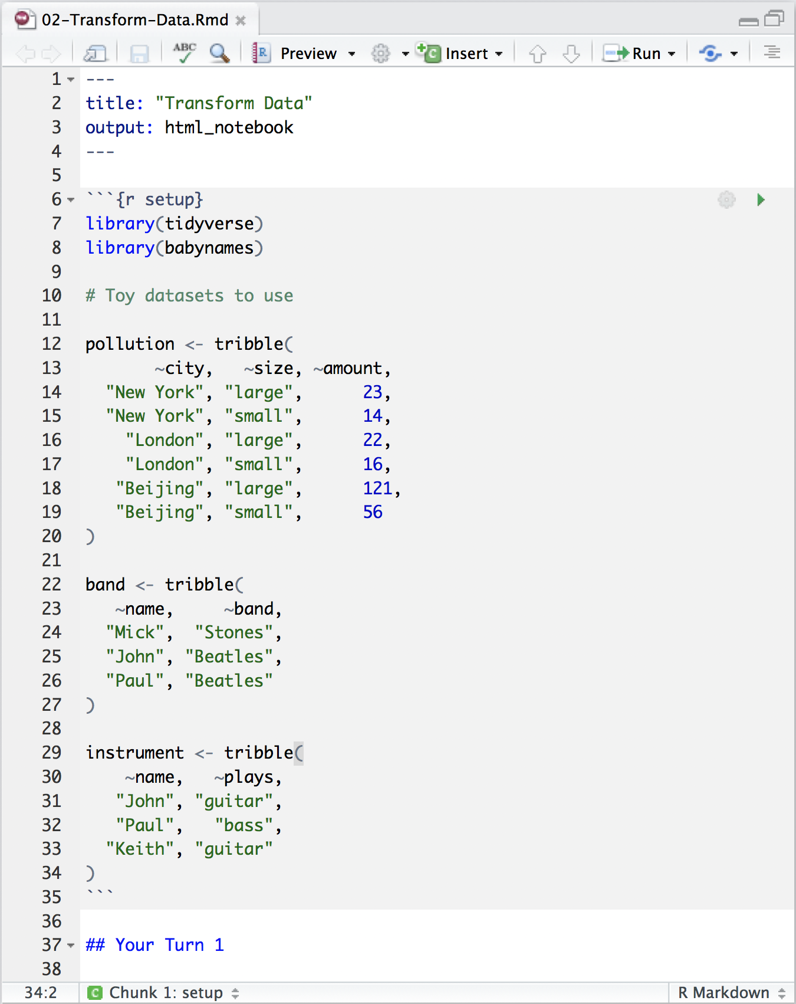
Transform Data Notebook
Toy data sets to practice with
CC BY-SA RStudio

Slide 80
pollution
city | particle size | amount (µg/m³)
New York | large | 23
New York | small | 14
London | large | 22
London | small | 16
Beijing | large | 121
Beijing | small | 56
CC BY-SA RStudio

Slide 81
city | particle size | amount (µg/m³)
New York | large | 23
New York | small | 14
London | large | 22
London | small | 16
Beijing | large | 121
Beijing | small | 56
mean | sum | n
42 | 252 | 6
pollution %>%
summarise(mean = mean(amount), sum = sum(amount), n = n())
CC BY-SA RStudio

Slide 82
city | particle size | amount (µg/m³)
New York | large | 23
New York | small | 14
London | large | 22
London | small | 16
Beijing | large | 121
Beijing | small | 56
mean | sum | n
42 | 252 | 6
CC BY-SA RStudio

Slide 83
city | particle size | amount (µg/m³)
New York | large | 23
New York | small | 14
mean | sum | n
42 | 252 | 6
London | large | 22
London | small | 16
Beijing | large | 121
Beijing | small | 56
CC BY-SA RStudio

Slide 84
city | particle size | amount (µg/m³)
New York | large | 23
New York | small | 14
mean | sum | n
18.5 | 37 | 2
mean | sum | n
18.5 | 37 | 2
London | large | 22
London | small | 16
19.0 | 38 | 2
19.0 | 38 | 2
Beijing | large | 121
Beijing | small | 56
88.5 | 177 | 2
88.5 | 177 | 2
group_by() + summarise()
CC BY-SA RStudio

Slide 85
group_by()
city | particle size | amount (µg/m³)
New York | large | 23
New York | small | 14
city | particle size | amount (µg/m³)
New York | large | 23
New York | small | 14
city | mean | sum | n
New York | 18.5 | 37 | 2
London | 19.0 | 38 | 2
Beijing | 88.5 | 177 | 2
London | large | 22
London | small | 16
London | large | 22
London | small | 16
Beijing | large | 121
Beijing | small | 56
Beijing | large | 121
Beijing | small | 56
pollution %>%
group_by(city) %>%
summarise(mean = mean(amount), sum = sum(amount), n = n())
CC BY-SA RStudio

Slide 86
Your Turn 9
Use group_by(), summarise(), and arrange() to display the ten most popular names. Compute popularity as the total number of children of a single gender given a name.

Slide 87
babynames %>%
group_by(name, sex) %>%
summarise(total = sum(n)) %>%
arrange(desc(total))
# name sex total
# 1 James M 5120990
# 2 John M 5095674
# 3 Robert M 4803068
# 4 Michael M 4323928
# 5 Mary F 4118058
# 6 William M 4071645
# 7 David M 3589754
# 8 Joseph M 2581785
# 9 Richard M 2558165
# 10 Charles M 2371621
# ... with 105,376 more rows
CC BY-SA RStudio

Slide 88
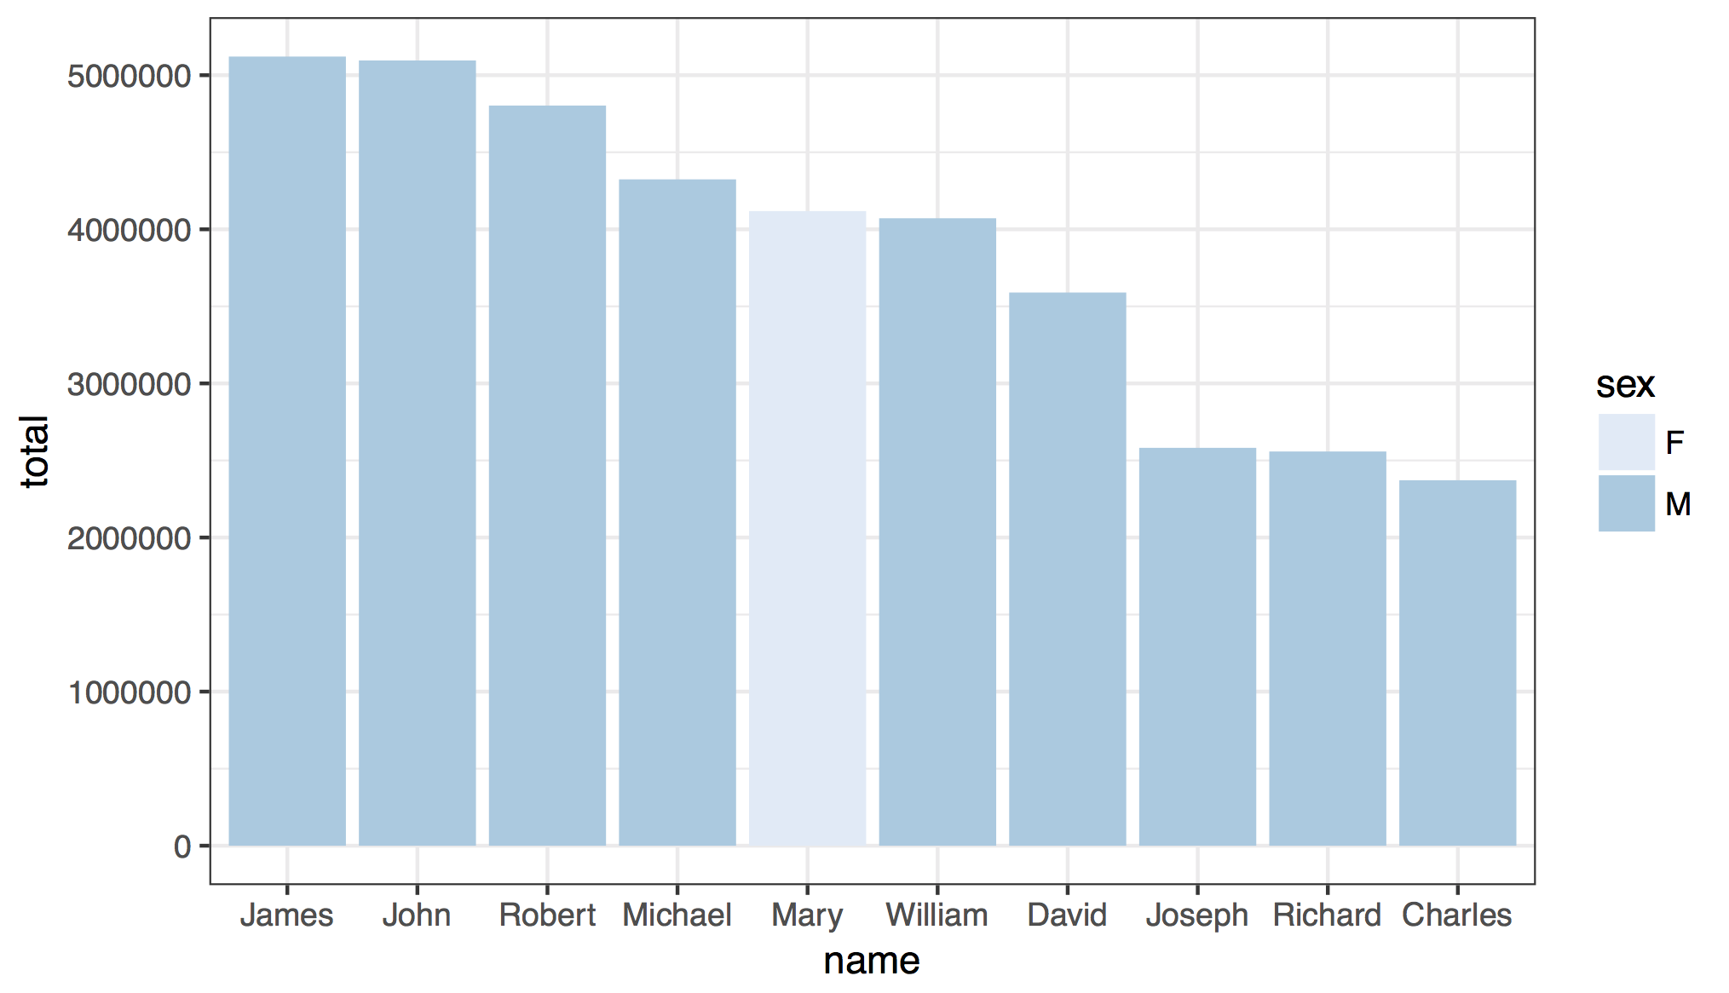
CC BY-SA RStudio

Slide 89
babynames %>%
group_by(name, sex) %>%
summarise(total = sum(n)) %>%
arrange(desc(total)) %>%
ungroup() %>%
slice(1:10) %>%
ggplot() +
geom_col(mapping = aes(x = fct_reorder(name, desc(total)), y = total, fill = sex)) +
theme_bw() +
scale_fill_brewer() +
labs(x = "name")
CC BY-SA RStudio

Slide 90
Your Turn 10
Use grouping to calculate and then plot the number of children born each year over time.

Slide 91
babynames %>%
group_by(year) %>%
summarise(n_children = sum(n)) %>%
ggplot() +
geom_line(mapping = aes(x = year, y = n_children))
CC BY-SA RStudio

Slide 92
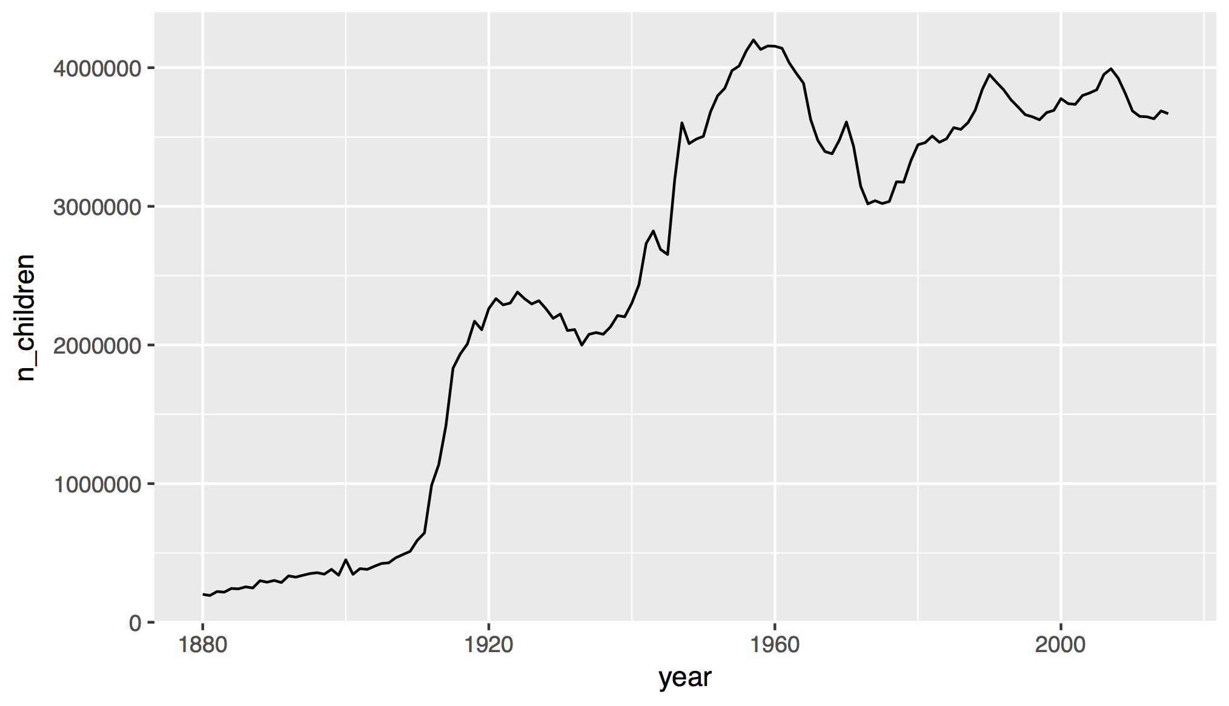
How does this affect our measure of popularity?
CC BY-SA RStudio

Slide 93
ungroup()
Removes grouping criteria from a data frame.
babynames %>%
group_by(name, sex) %>%
summarise(total = sum(n)) %>%
arrange(desc(total))
# name sex total
# 1 James M 5120990
# 2 John M 5095674
# 3 Robert M 4803068
# 4 Michael M 4323928
# 5 Mary F 4118058
# 6 William M 4071645
# 7 David M 3589754
CC BY-SA RStudio

Slide 94
ungroup()
Removes grouping criteria from a data frame.
babynames %>%
group_by(name, sex) %>%
ungroup() %>%
summarise(total = sum(n)) %>%
arrange(desc(total))
# total
# 1 340851912
CC BY-SA RStudio

Slide 95
mutate()

Slide 96
mutate()
Create new columns.
babynames %>%
mutate(percent = round(prop*100, 2))
babynames
year | sex | name | n | prop
1880 | M | John | 9655 | 0.0815
1880 | M | William | 9532 | 0.0805
1880 | M | James | 5927 | 0.0501
1880 | M | Charles | 5348 | 0.0451
1880 | M | Garrett | 13 | 0.0001
1881 | M | John | 8769 | 0.081
1881 | M | William | 8524 | 0.0787
1881 | M | James | 5442 | 0.0503
1881 | M | Charles | 4664 | 0.0431
1881 | M | Garrett | 7 | 0.0001
1881 | M | Gideon | 7 | 0.0001
year | sex | name | n | prop | percent
1880 | M | John | 9655 | 0.0815 | 8.15
1880 | M | William | 9532 | 0.0805 | 8.05
1880 | M | James | 5927 | 0.0501 | 5.01
1880 | M | Charles | 5348 | 0.0451 | 4.51
1880 | M | Garrett | 13 | 0.0001 | 0.01
1881 | M | John | 8769 | 0.081 | 8.1
1881 | M | William | 8524 | 0.0787 | ratio
1881 | M | James | 5442 | 0.0503 | 9.15
1881 | M | Charles | 4664 | 0.0431 | 22.42
1881 | M | Garrett | 7 | 0.0001 | 15.46
1881 | M | Gideon | 7 | 0.0001 | 25.32
CC BY-SA RStudio

Slide 97
mutate()
Create new columns.
babynames %>%
mutate(percent = round(prop*100, 2), nper = round(percent))
babynames
year | sex | name | n | prop
1880 | M | John | 9655 | 0.0815
1880 | M | William | 9532 | 0.0805
1880 | M | James | 5927 | 0.0501
1880 | M | Charles | 5348 | 0.0451
1880 | M | Garrett | 13 | 0.0001
1881 | M | John | 8769 | 0.081
1881 | M | William | 8524 | 0.0787
1881 | M | James | 5442 | 0.0503
1881 | M | Charles | 4664 | 0.0431
1881 | M | Garrett | 7 | 0.0001
1881 | M | Gideon | 7 | 0.0001
year | sex | name | n | prop | percent | nper
1880 | M | John | 9655 | 0.0815 | 8.15 | 8
1880 | M | William | 9532 | 0.0805 | 8.05 | 8
1880 | M | James | 5927 | 0.0501 | 5.01 | 5
1880 | M | Charles | 5348 | 0.0451 | 4.51 | 5
1880 | M | Garrett | 13 | 0.0001 | 0.01 | 0
1881 | M | John | 8769 | 0.081 | 8.1 | 8
1881 | M | William | 8524 | 0.0787 | ratio
1881 | M | James | 5442 | 0.0503 | 9.15
1881 | M | Charles | 4664 | 0.0431 | 22.42
1881 | M | Garrett | 7 | 0.0001 | 15.46
1881 | M | Gideon | 7 | 0.0001 | 25.32
CC BY-SA RStudio

Slide 98
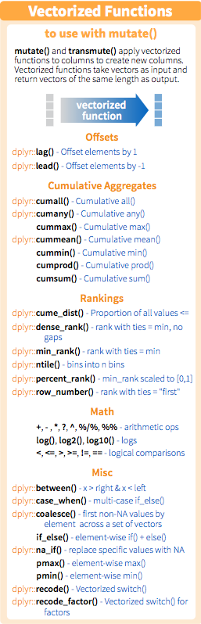
Vectorized functions
Take a vector as input.
Return a vector of the same length as output.
CC BY-SA RStudio

Slide 99
min_rank()
A go to ranking function (ties share the lowest rank)
min_rank(c(50, 100, 1000))
# [1] 1 2 3
min_rank(desc(c(50, 100, 1000)))
# [1] 3 2 1
CC BY-SA RStudio

Slide 100
Your Turn 11
Use min_rank() and mutate() to rank each row in babynames from largest n to lowest n.

Slide 101
babynames %>%
mutate(rank = min_rank(desc(prop)))
# year sex name n prop rank
# 1 1880 F Mary 7065 0.07238433 14
# 2 1880 F Anna 2604 0.02667923 709
# 3 1880 F Emma 2003 0.02052170 1131
# 4 1880 F Elizabeth 1939 0.01986599 1192
# 5 1880 F Minnie 1746 0.01788861 1427
# 6 1880 F Margaret 1578 0.01616737 1683
# 7 1880 F Ida 1472 0.01508135 1897
# 8 1880 F Alice 1414 0.01448711 2040
# 9 1880 F Bertha 1320 0.01352404 2279
# 10 1880 F Sarah 1288 0.01319618 2387
# ... with 1,858,679 more rows
CC BY-SA RStudio

Slide 102
Your Turn 12
Compute each name's rank within its year and sex.
Then compute the median rank for each combination of name and sex, and arrange the results from highest median rank to lowest.

Slide 103
babynames %>%
group_by(year, sex) %>%
mutate(rank = min_rank(desc(prop))) %>%
group_by(name, sex) %>%
summarise(score = median(rank)) %>%
arrange(score)
# name sex score
# 1 Mary F 1
# 2 James M 3
# 3 John M 3
# 4 William M 4
# 5 Robert M 6
# ... with 105,381 more rows
CC BY-SA RStudio

Slide 104
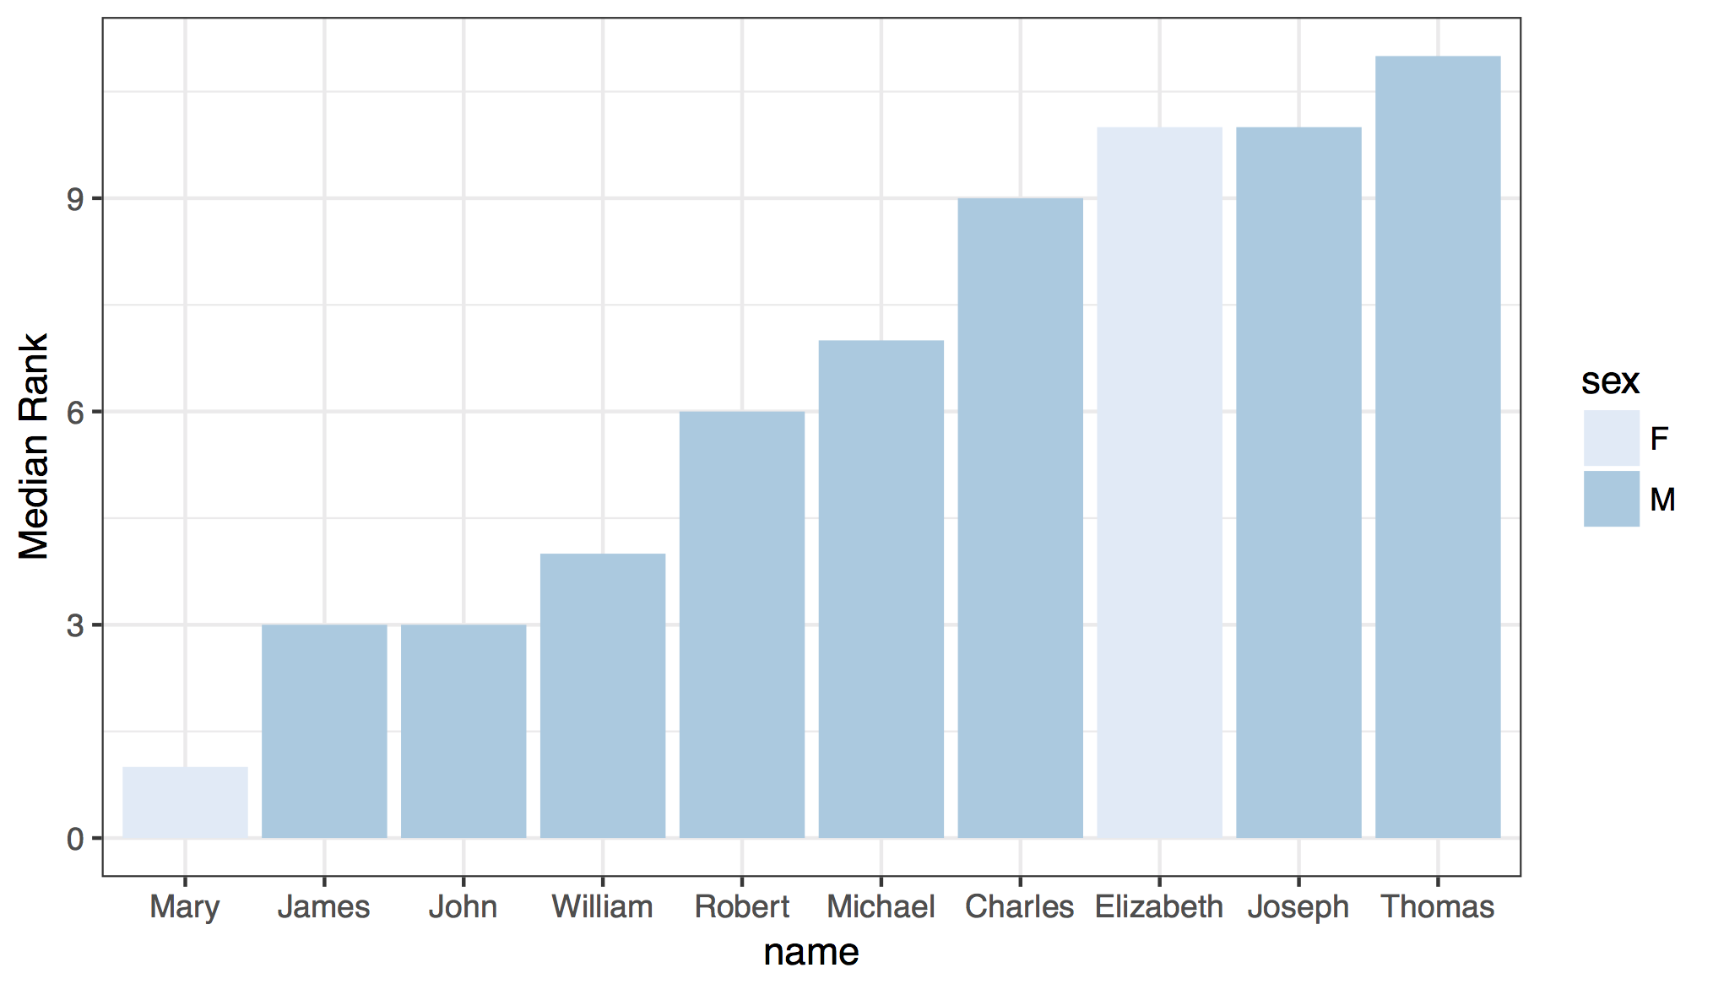
CC BY-SA RStudio

Slide 105
babynames %>%
group_by(year, sex) %>%
mutate(rank = min_rank(desc(prop))) %>%
group_by(name, sex) %>%
summarise(score = median(rank)) %>%
ungroup() %>%
arrange(score) %>%
slice(1:10) %>%
ggplot() +
geom_col(mapping = aes(x = fct_reorder(name, score), y = score, fill = sex)) +
theme_bw() +
scale_fill_brewer() +
labs(x = "name", y = "Median Rank")
CC BY-SA RStudio

Slide 106
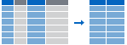
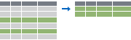
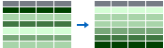

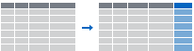
Recap: Single table verbs
Extract variables with select()
Extract cases with filter()
Arrange cases, with arrange().
Make tables of summaries with summarise().
Make new variables, with mutate().
CC BY-SA RStudio

Slide 107
Joining Datasets

Slide 108
nycflights13
Data about every flight that departed La Guardia, JFK, or Newark airports in 2013
❒
# install.packages("nycflights13")
library(nycflights13)
CC BY-SA RStudio

Slide 109
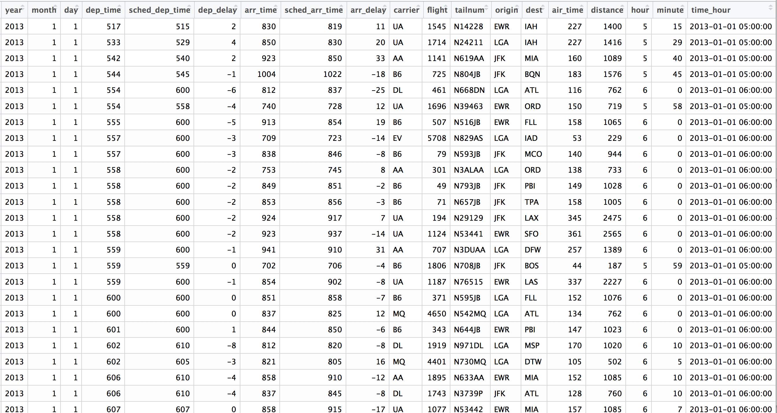
Flights
View(flights)
CC BY-SA RStudio

Slide 110
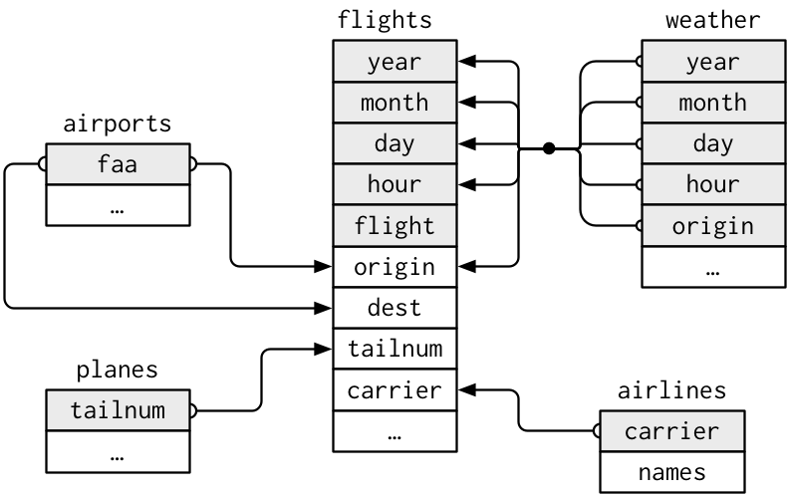
nycflights13
year
…
CC BY-SA RStudio

Slide 111
nycflights13
What airline had the longest delays?
year
…
CC BY-SA RStudio

Slide 112
nycflights13
What airline used the newest planes?
year
…
CC BY-SA RStudio

Slide 113
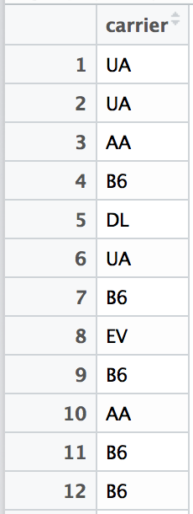
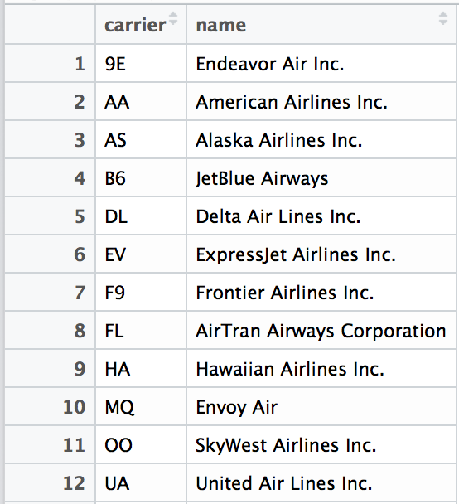
Airline names
View(flights["carrier"])
View(airlines)
CC BY-SA RStudio

Slide 114
mutating joins

Slide 115
common syntax
Each join function returns a data frame / tibble.
left_join(x, y, by = NULL, … )
join function
data frames to join
names of columns to join on
CC BY-SA RStudio

Slide 116
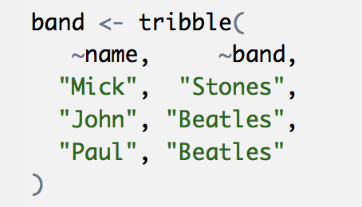
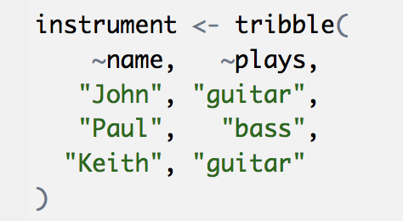
Toy data
band
name | band
Mick | Stones
John | Beatles
Paul | Beatles
instrument
instrument2 <- tribble(
~artist, ~plays,
"John", "guitar",
"Paul", "bass",
"Keith", "guitar"
)
name | plays
John | guitar
Paul | bass
Keith | guitar
CC BY-SA RStudio

Slide 117
Toy data
band
instrument
name | band
Mick | Stones
John | Beatles
Paul | Beatles
name | plays
John | guitar
Paul | bass
Keith | guitar
CC BY-SA RStudio

Slide 118
left
band %>% left_join(instrument, by = "name")
band
instrument
name | band
Mick | Stones
John | Beatles
Paul | Beatles
name | plays
John | guitar
Paul | bass
Keith | guitar
name | band | plays
Mick | Stones | <NA>
John | Beatles | guitar
Paul | Beatles | bass
+
=
CC BY-SA RStudio

Slide 119
right
band %>% right_join(instrument, by = "name")
band
instrument
name | band
Mick | Stones
John | Beatles
Paul | Beatles
name | plays
John | guitar
Paul | bass
Keith | guitar
name | band | plays
John | Beatles | guitar
Paul | Beatles | bass
Keith | <NA> | guitar
+
=
CC BY-SA RStudio

Slide 120
full
band %>% full_join(instrument, by = "name")
band
instrument
name | band
Mick | Stones
John | Beatles
Paul | Beatles
name | plays
John | guitar
Paul | bass
Keith | guitar
name | band | plays
Mick | Stones | <NA>
John | Beatles | guitar
Paul | Beatles | bass
Keith | <NA> | guitar
+
=
CC BY-SA RStudio

Slide 121
inner
band %>% inner_join(instrument, by = "name")
band
instrument
name | band
Mick | Stones
John | Beatles
Paul | Beatles
name | plays
John | guitar
Paul | bass
Keith | guitar
name | band | plays
John | Beatles | guitar
Paul | Beatles | bass
+
=
CC BY-SA RStudio

Slide 122
Airline names
View(flights["carrier"])
View(airlines)
CC BY-SA RStudio

Slide 123
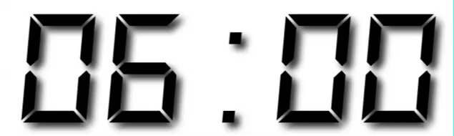
Your Turn 13
Which airlines had the largest arrival delays? Work in groups to complete the code below.
flights %>%
drop_na(arr_delay) %>%
%>%
group_by( ) %>%
%>%
arrange( )
1. Join airlines to flights
2. Compute and order the average arrival delays by airline. Display full names, no codes.

Slide 124
flights %>%
drop_na(arr_delay) %>%
left_join(airlines, by = "carrier") %>%
group_by(name) %>%
summarise(delay = mean(arr_delay)) %>%
arrange(delay)
## # A tibble: 16 × 2
## name delay
## <chr> <dbl>
## 1 Alaska Airlines Inc. -9.9308886
## 2 Hawaiian Airlines Inc. -6.9152047
## 3 American Airlines Inc. 0.3642909
## 4 Delta Air Lines Inc. 1.6443409
## 5 Virgin America 1.7644644
CC BY-SA RStudio

Slide 125
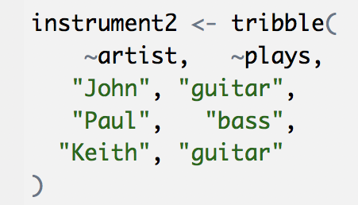
Toy data
band
name | band
Mick | Stones
John | Beatles
Paul | Beatles
instrument2
artist | plays
John | guitar
Paul | bass
Keith | guitar
CC BY-SA RStudio

Slide 126
What if the names do not match?
Use a named vector to match on variables with different names.
band %>% left_join(instrument2, by = c("name" = "artist"))
A named vector
The name of the element = the column name in the first data set
The value of the element = the column name in the second data set
CC BY-SA RStudio

Slide 127
common syntax - matching names
band %>% left_join(instrument2, by = c("name" = "artist"))
band
instrument2
name | band
Mick | Stones
John | Beatles
Paul | Beatles
artist | plays
John | guitar
Paul | bass
Keith | guitar
name | band | plays
Mick | Stones | <NA>
John | Beatles | guitar
Paul | Beatles | bass
+
=
CC BY-SA RStudio

Slide 128
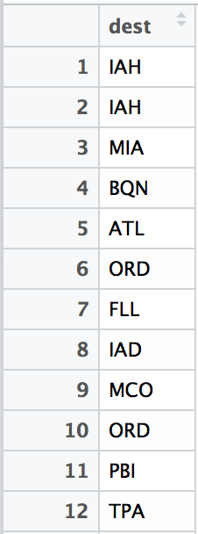
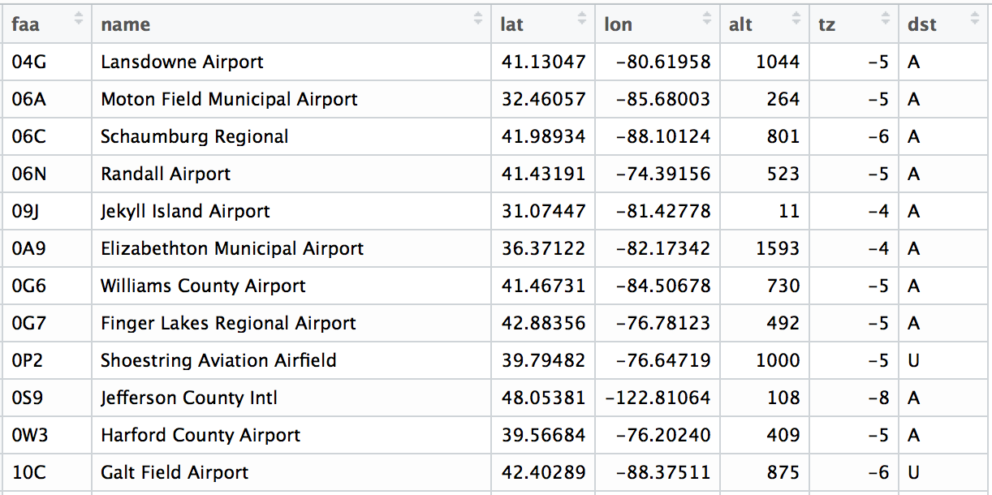
Airport names
View(flights["dest"])
View(airports)
CC BY-SA RStudio

Slide 129
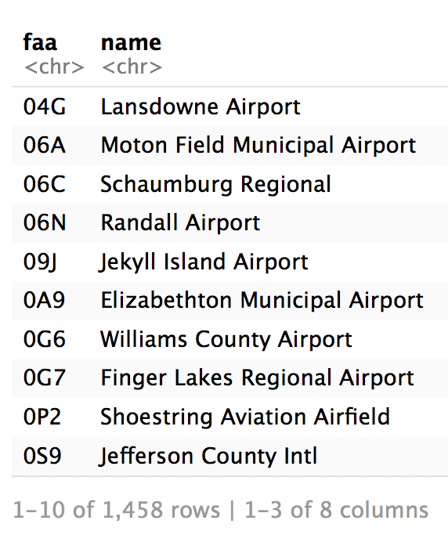
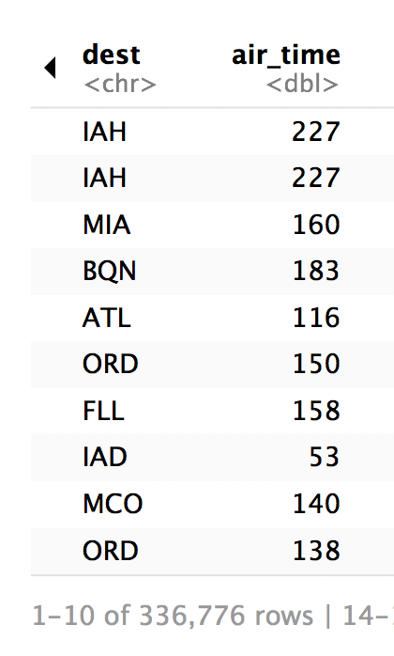
Airport names
airports %>% select(1:3)
flights %>% select(14:15)
CC BY-SA RStudio

Slide 130
common syntax - matching names
airports %>% left_join(flights, by = c("faa" = "dest"))
CC BY-SA RStudio

Slide 131
Your Turn 14
Use flights and airports to compute the distance and average arr_delay by destination airport (names only, not codes). Order by average delay, worst to best.
Hint: use first() to get distance.

Slide 132
flights %>%
drop_na(arr_delay) %>%
left_join(airports, by = c("dest" = "faa")) %>%
group_by(name) %>%
summarise(distance = first(distance),
delay = mean(arr_delay)) %>%
arrange(desc(delay))
## # A tibble: 101 × 3
## name distance delay
## <chr> <dbl> <dbl>
## 1 Columbia Metropolitan 602 41.76415
## 2 Tulsa Intl 1215 33.65986
## 3 Will Rogers World 1325 30.61905
CC BY-SA RStudio

Slide 133
filtering joins

Slide 134
filtering joins
Mutating joins use information from one data set to add variables to another data set (like mutate())
Filtering joins use information from one data set to extract cases from another data set (like filter())
CC BY-SA RStudio

Slide 135
semi
band %>% semi_join(instrument, by = "name")
band
instrument
name | band
Mick | Stones
John | Beatles
Paul | Beatles
name | plays
John | guitar
Paul | bass
Keith | guitar
name | band
John | Beatles
Paul | Beatles
+
=
CC BY-SA RStudio

Slide 136
anti
band %>% anti_join(instrument, by = "name")
band
instrument
name | band
Mick | Stones
John | Beatles
Paul | Beatles
name | plays
John | guitar
Paul | bass
Keith | guitar
name | band
Mick | Stones
+
=
CC BY-SA RStudio

Slide 137
Airport names
airports %>% select(1:3)
flights %>% select(14:15)
CC BY-SA RStudio

Slide 138
Your Turn 14
How many airports in airports are serviced by flights originating in New York (i.e. flights in our dataset?)
Notice that the column to join on is named faa in the airports dataset and dest in the flights dataset.

Slide 139
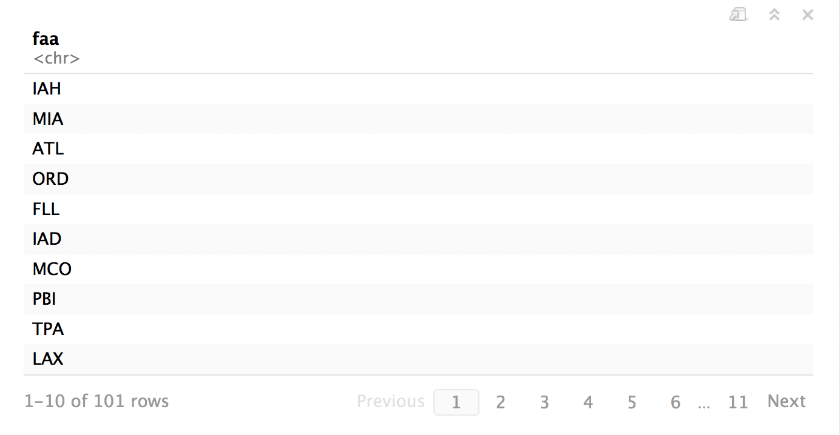
airports %>%
semi_join(flights, by = c("faa" = "dest")) %>%
distinct(faa)
CC BY-SA RStudio

Slide 140
distinct()
Removes rows with duplicate values (in a column).
distinct(df, name)
df
name | band
Mick | Stones
John | Beatles
John | Zeppelin
name
Mick
John
CC BY-SA RStudio

Slide 141
distinct()
Removes rows with duplicate values (in a column).
distinct(instrument, plays)
instrument
name | plays
John | guitar
Paul | bass
Keith | guitar
plays
guitar
bass
CC BY-SA RStudio

Slide 142
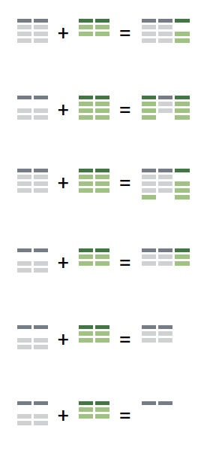
Recap: Two table verbs
left_join() retains all cases in left data set
right_join() retains all cases in right data set
full_join() retains all cases in either data set
inner_join() retains only cases in both data sets
semi_join() extracts cases that have a match
anti_join() extracts cases that do not have a match
CC BY-SA RStudio

Slide 143
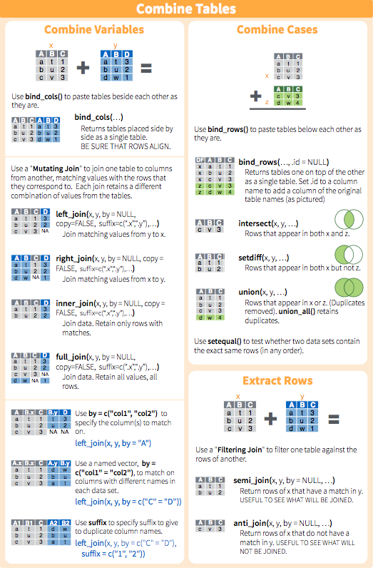
Two table verbs
CC BY-SA RStudio

Slide 144
Tidy tools

Slide 145
Tidy tools
Functions are easiest to use when they are:
Simple - They do one thing, and they do it well
Composable - They can be combined with other functions for multi-step operations
Smart - They can use R objects as input.
Tidy functions do these things in a specific way.
CC BY-SA RStudio

Slide 146
1. Simple - They do one thing, and they do it well
filter() - extract cases
arrange() - reorder cases
group_by() - group cases
select() - extract variables
mutate() - create new variables
summarise() - summarise variables / create cases
CC BY-SA RStudio

Slide 147
2. Composable - They can be combined with other functions for multi-step operations
%>%
babynames mutate( , percent = prop * 100)
Each dplyr function takes a data frame as its first argument and returns a data frame. As a result, you can directly pipe the output of one function into the next.
CC BY-SA RStudio

Slide 148
3. Smart - They can use R objects as input.
TODO: Dplyr functions use non-standard evaluation, which means that you cannot simply pass an R object.
CC BY-SA RStudio

Slide 149
babynames %>% filter(n > 500)
These objects are looked up in babynames
These objects are looked up in the scope of x
x <- n > 500
babynames %>% filter(x) # ERROR!
CC BY-SA RStudio

Slide 150
_ functions
Every major dplyr function comes with a programming friendly version that accepts formulas. The version has an _ at the end of its name.
~ saves the expression as a formula
filter_()
x <- ~n > 500
babynames %>% filter_(x) # Works :)
CC BY-SA RStudio

Slide 152
Section

Slide 153
Code
HTTP Verb
HTTP version
URL path
URL path
GET /resources/webinars/ HTTP/1.1
Host: www.rstudio.com
User-Agent: libcurl/7.43.0 r-curl/2.1 httr/1.2.1
Accept-Encoding: gzip, deflate
Accept: application/json, text/xml, application/xml, */*
CC BY-SA RStudio

Slide 154

Your Turn
Open R. Then download the packages that we will use today by running the following code.

